Slide 1

CSA1521-Cloud Computing And Big Data Analytics
The Role Of Data Centres in Cloud Computing
Guide by
Dr. Santhiya Lakshmi
Presented by
Yogashree G (192573022)

Slide 2


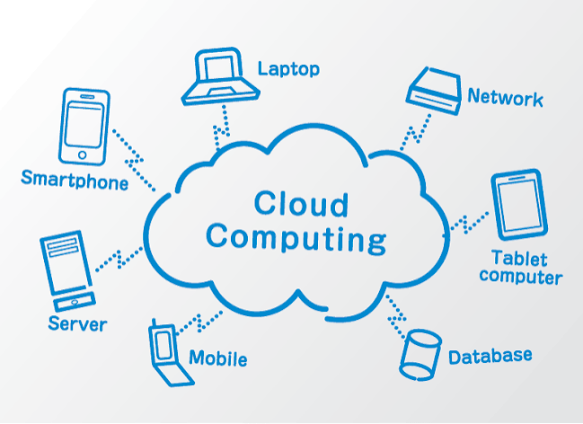
Introduction
The role of data centers in cloud computing. To learn how data centers support cloud services and applications. To study the basic architecture of a cloud data center. To explore a real-world example of cloud data center usage. To understand the benefits and importance of data centers in delivering reliable cloud services.

Slide 3
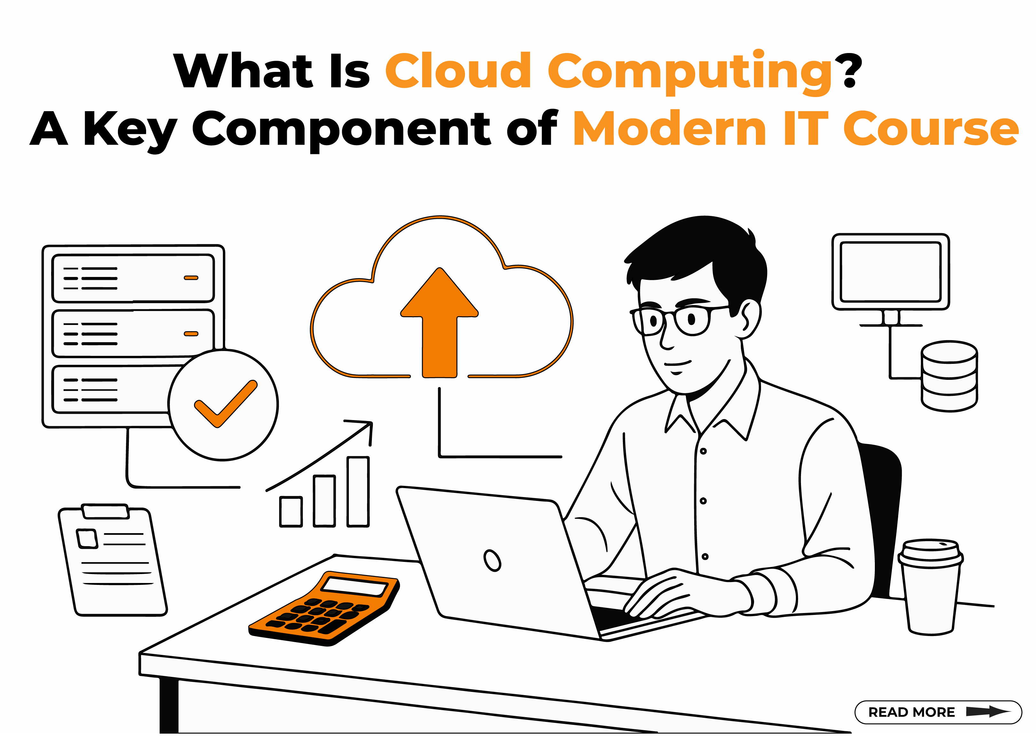
Core Technical
Explanation
A data center stores and processes data.
It contains servers, storage, and networking devices.
Supports cloud applications and virtual machines.
Provides secure and reliable services.
Enables resource sharing over the Internet.

Slide 4
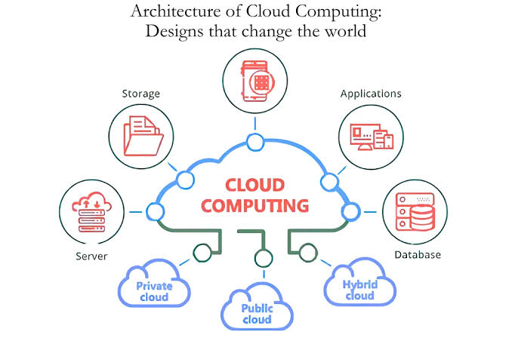
Cloud Data Centre
Architecture
Users access services through the Internet.
Load balancer distributes user requests.
Servers run cloud applications.
Hypervisor creates and manages virtual machines.
Storage and networking connect all resources.

Slide 5
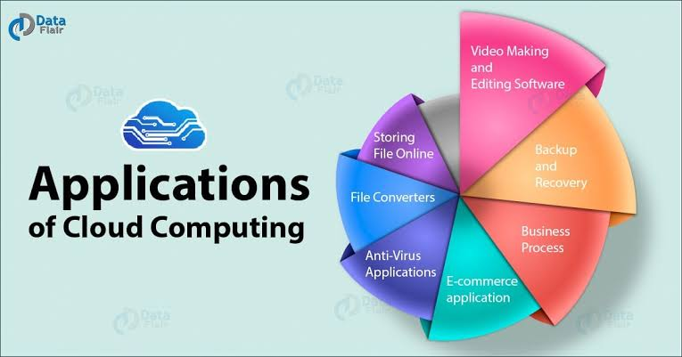
Real World Use Case
User uploads a file to AWS.
Servers process the request.
Data is stored securely.
Backup copies are maintained.
Users can access data anytime.

Slide 6
Conclusion
Data centers are the backbone of cloud computing.
They provide storage, computing, and networking.
Virtualization improves resource utilization.
Ensure secure and scalable cloud services.
Used by AWS, Azure, and Google Cloud.

Slide 7
THANK YOU!

